Slide 1
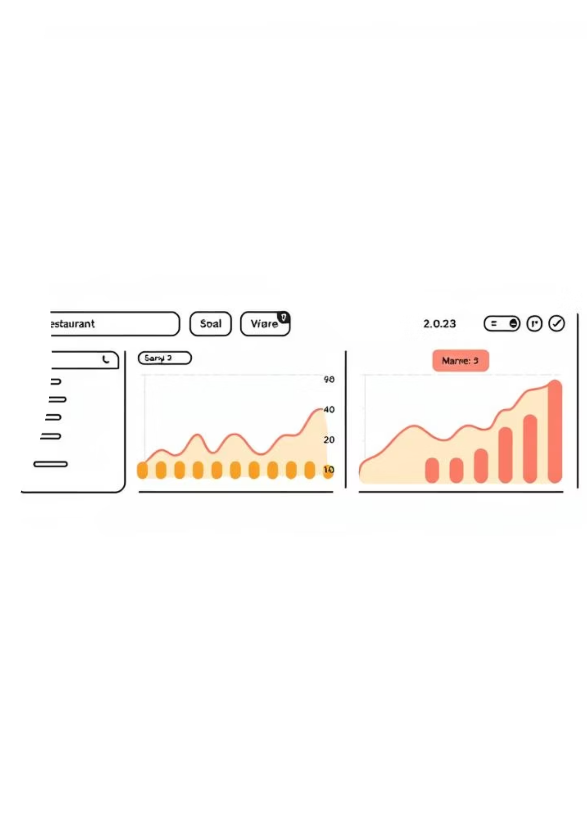
🍽 Restaurant POS & Analytics Dashboard
Full-Stack Order Management & Sales Analytics System

Slide 2

Project Overview
A comprehensive solution for restaurants, cafés, and takeaways to manage orders, payments, and sales analytics in real-time.
Purpose
Key Technologies
Real-time order, payment & sales analytics.
Python, Flask, SQLite, TailwindCSS, Chart.js.

Slide 3






Core Features
Order Management
Payment Simulation
Dine-In, Takeaway, Delivery options.
UPI, Card, Cash options.
PDF Invoice
Admin Panel
Automated generation.
Secure login & management.
Sales Analytics
CSV Export
KPIs & Charts.
For reports.

Slide 4

System Architecture
The system is built with a clear separation of concerns: Flask for the backend, HTML/TailwindCSS for the frontend, and SQLite for the database.
Backend
Frontend
Flask
HTML, TailwindCSS
Database
SQLite

Slide 5
Key Modules in Detail
01
02
03
Order Management Flow
Analytics Dashboard
Admin Panel
Select items → Calculate GST → Confirm Payment → Generate Invoice.
KPIs, Sales Trends, Top Selling Items, Payment Method Distribution.
Menu Management, CSV Import/Export functionality.

Slide 6
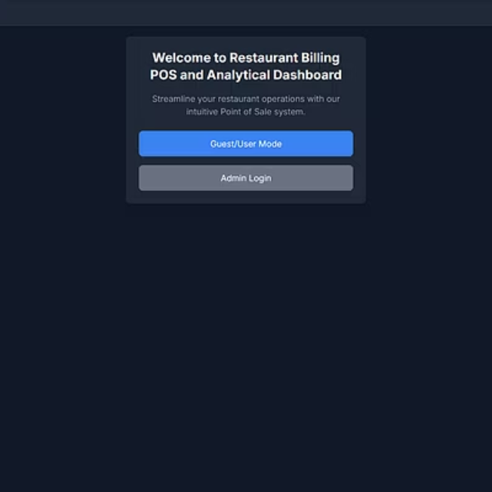
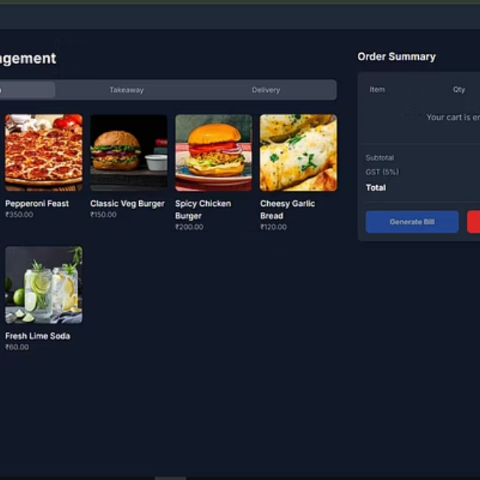
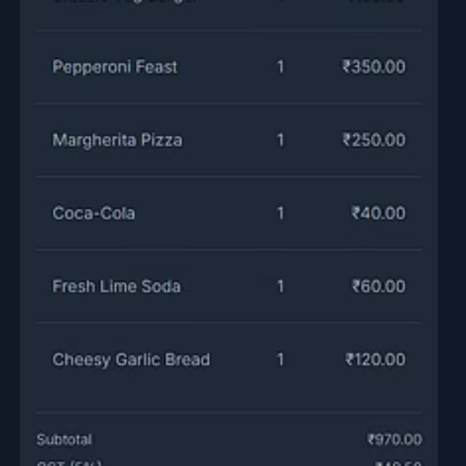
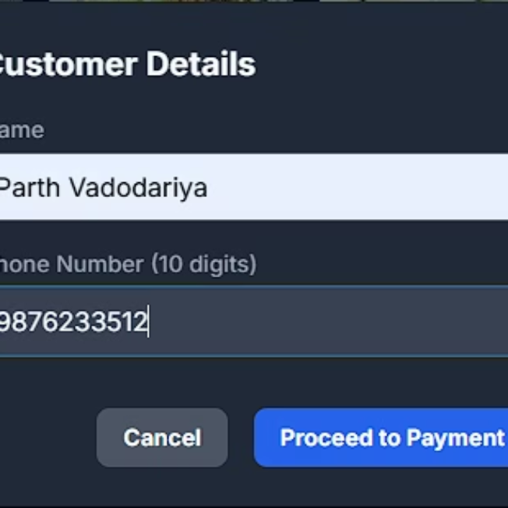
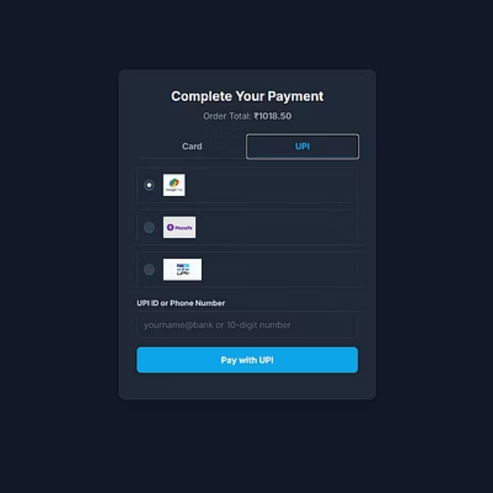
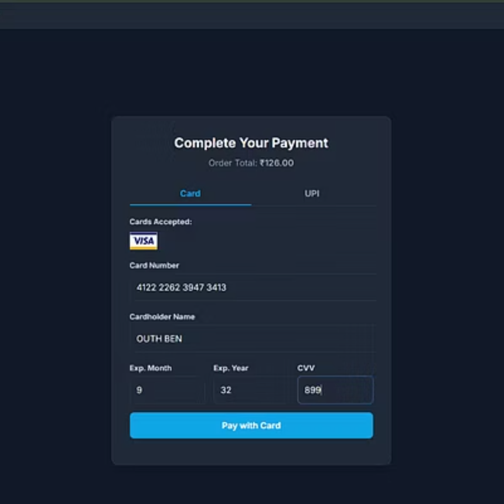
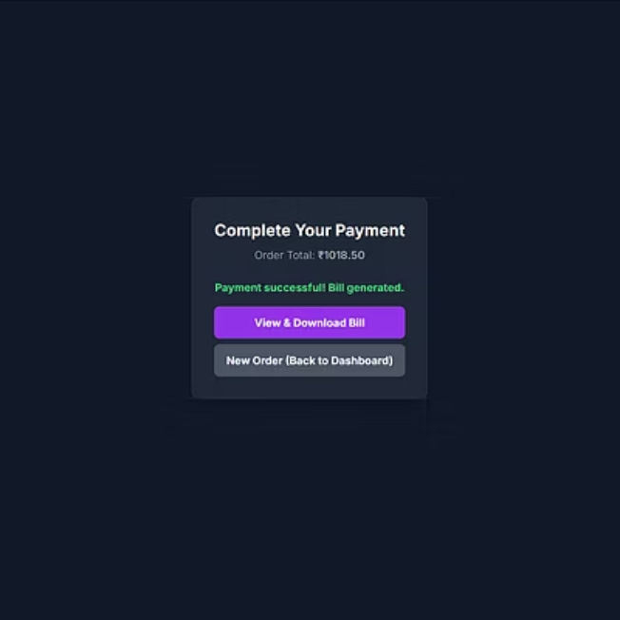
Project Preview

Slide 7
API Endpoints
Endpoint
Description
/menu
Retrieve menu items
/order
Place a new order
/order/<id>/pay
Process payment for an order
/analytics/dashboard
View sales analytics dashboard
/analytics/items-sales/export
Export item sales data to CSV

Slide 8



Security Features
Admin Authentication
Password Hashing
Session Management
Powered by flask-login.
Using bcrypt for secure storage.
Ensuring secure user sessions.

Slide 9

Thank You!
Demo Disclaimer: All payments are simulated for demo purposes. No real transactions occur.

Slide 10
Thank You!
Demo Disclaimer: All payments are simulated for demo purposes. No real transactions occur.

